Slide 1
E-DISCOVERY
The Sophomore Year
May 20, 2010

Slide 2
E-Discovery:
The Sophomore Year
Presented by Mary Mack
Corporate Technology Counsel
Fios, Inc.

Slide 3


Save Money by Reusing Evidence
Code Once for Junk and Priv Review/Redaction
De-duplicate New Collections “Refresh Collections”
Setup Needed

Slide 4
Documenting Proportionality (Data Reduction)
Court Consumable Search Documentation
  Intel v AMD In Re Intel Corp. Microprocessor Antitrust Litig.,2008 WL 2310288 (D.Del. June 4, 2008)
The Art and Science of Sampling
  Achieving Quality in the E-Discovery Process (Sampling) http://ow.ly/1Km3V

Slide 5

Shift Costs of Preservation
Early Negotiations
Consider Mediation
Understand Internal Costs
Proportionality http://ow.ly/1Iqzn

Slide 6

Leading Edge Technical Challenges
Shared Files
Sharepoint
Databases
Third Party Applications (Salesforce, ADP)
Personal Information (US, Europe, Health)

Slide 7





Leading Edge Technical Challenges
Social Media
Companies Try to Block Internal Network Users From Accessing Social Media Websites
Practical Preservation Strategies

Slide 8
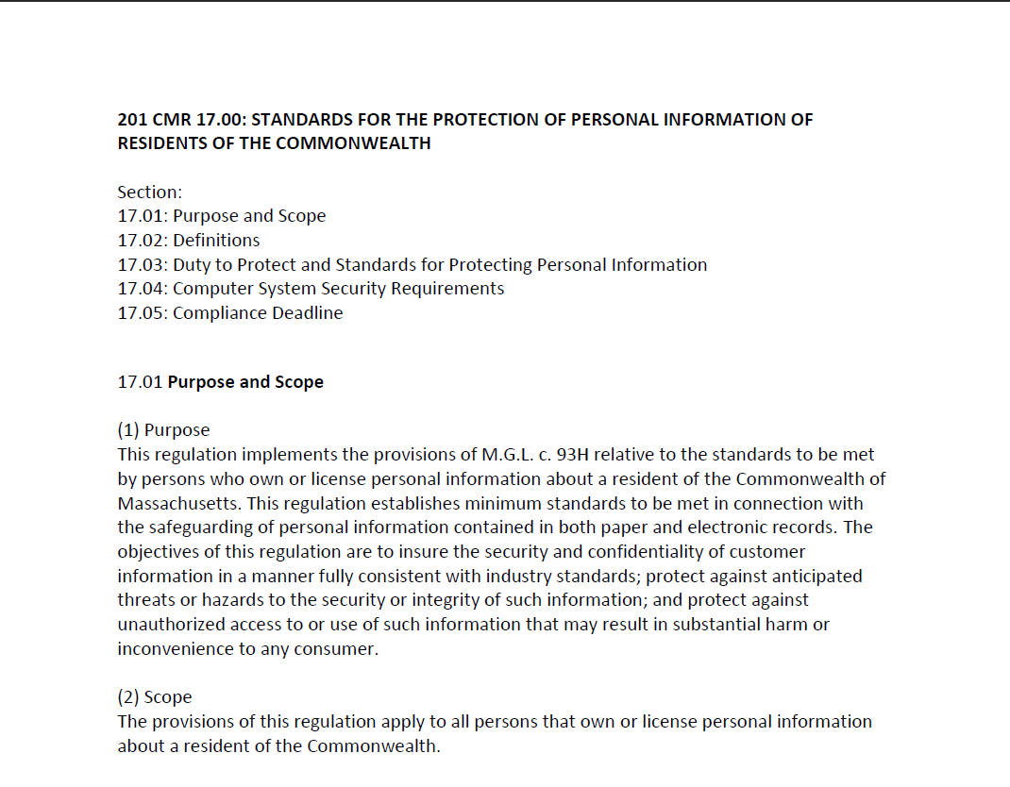

Security and Data Breach Legislation
Massachusetts Data Protection Act 201 CMR 17

Slide 9
Employment and Securities
Longer Statute of Limitation Challenges
Employment
  Lilly Ledbetter Fair Pay Act of 2009
Securities
  Merck & Co. v. Reynolds, No. 08-905, 2010

Slide 10
Preservation and the “Trigger” Question
Adams v Dell 2009 WL 910801 (D.Utah)
Goodman v. Praxair Servs, Inc. 632 F.Supp.2d 494 (D.Md. 2009)
  The issues addressed by Judge Grimm in Praxair include:
  The trigger date for a duty to preserve
  The timeliness of a spoliation motion.
  Identifying the “key players” to whom the litigation hold should be directed.
  Determining what ESI is under a party’s control.
  Distinguishing the duty to preserve from the duty to produce.
  Ediscovery and small “mom and pop” companies.
  Whether sanctions can be imposed for the spoliation of evidence by an agent.
  State of mind required for spoliation sanctions.
  Four scenarios when costs and attorney fees are allowed.
  Sanctions for unilaterally preserving only the ESI that a party deems relevant.

Slide 11

Sourcing Talent
Look within …

Slide 12

Educated IT Department = Double-edged Sword
Corporate Counsel Open Door Policy (provide guidance)
Avoid Misinterpretation of FRCP

Slide 13
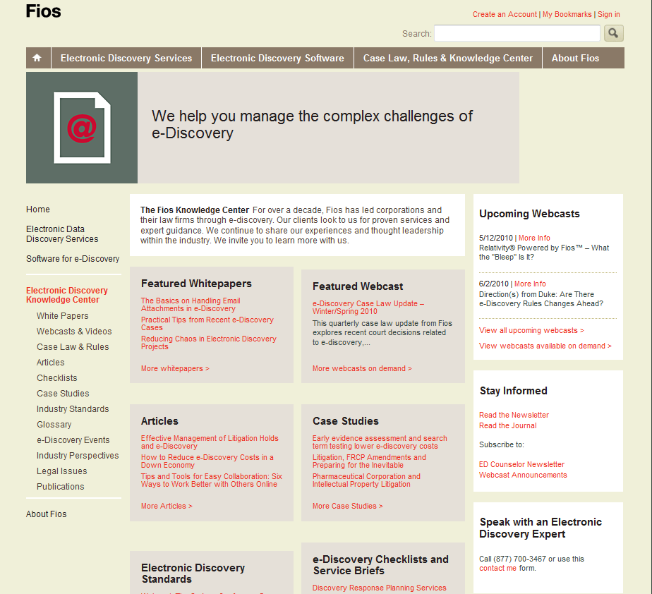
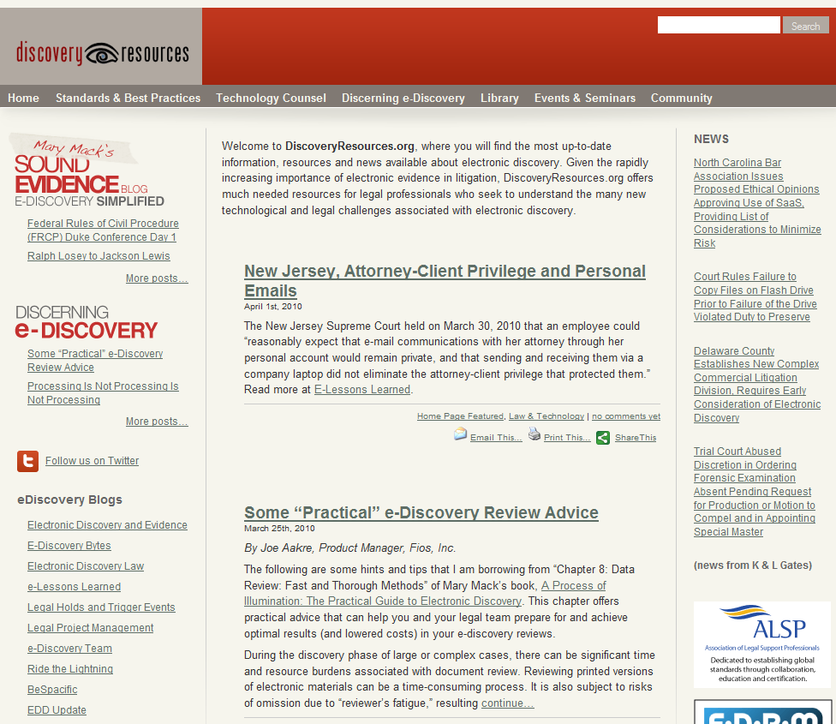
Keeping Up
Electronic Discovery Resources
www.fiosinc.com
www.discoveryresources.org

Slide 14
Selling E-Discovery to Your Management
Presented by Mary Mack
Corporate Technology Counsel
Fios, Inc.

Slide 15



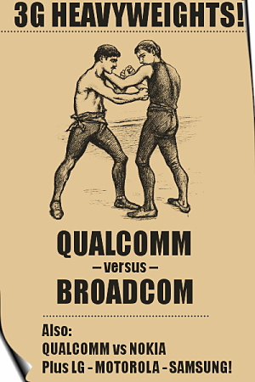
Sanctions - Inside Counsel, Corporate - Costs $$
US v. Philip Morris USA, Inc. 2004 WL 1627252 (D.DC)
  $2.75 million
  $250K per executive
Qualcomm, Inc. v. Broadcom Corporation, No. 05-CV-1958-B (BLM), 2008 WL 66932 (S.D. Cal. Jan. 7, 2008)
  $8.5m

Slide 16

Sanctions
Adverse Inference
Not Being Able to Produce Favorable Evidence
Costs of Losing the Case
Morgan Stanley (Penny Wise, Pound Foolish)
  $1.5 billion
  Reversed on other grounds

Slide 17

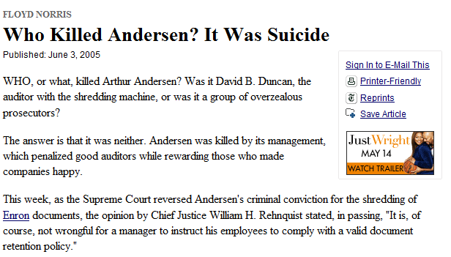
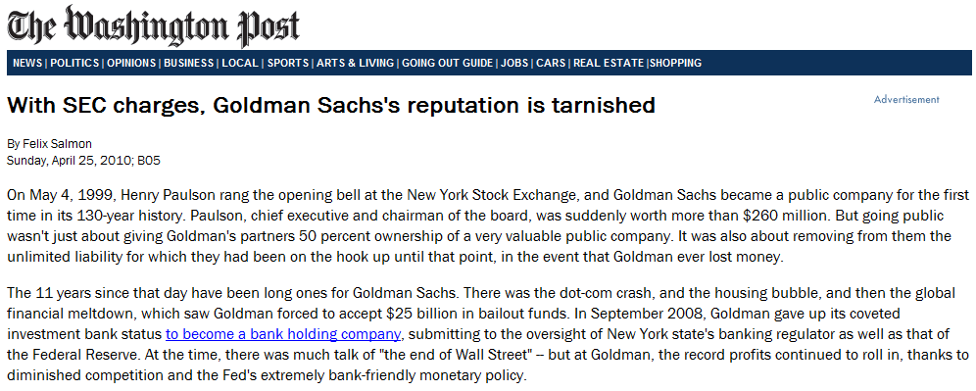
Reputation Management
Arthur Andersen LLP v. U.S., 544 U.S. 696 (2005)
Goldman Sachs

Slide 18
Insurance Coverage
Reduce Insurance Premiums
Make Sure You are Covered
  Pension Comm. of the Univ. of Montreal Pension Plan v. Banc of Am. Sec., LLC., 2010 WL 184312 (S.D.N.Y. Jan. 15, 2010)
  Gross Negligence — Foreseeable Events
    Failure to issue written legal hold notice
    Failure to identify key players and ensure records preserved
    Failure to preserve records of former employees
    Failure to preserve backup tapes if:
      Sole source of relevant information
      Only reasonably accessible source of information for key players

Slide 19
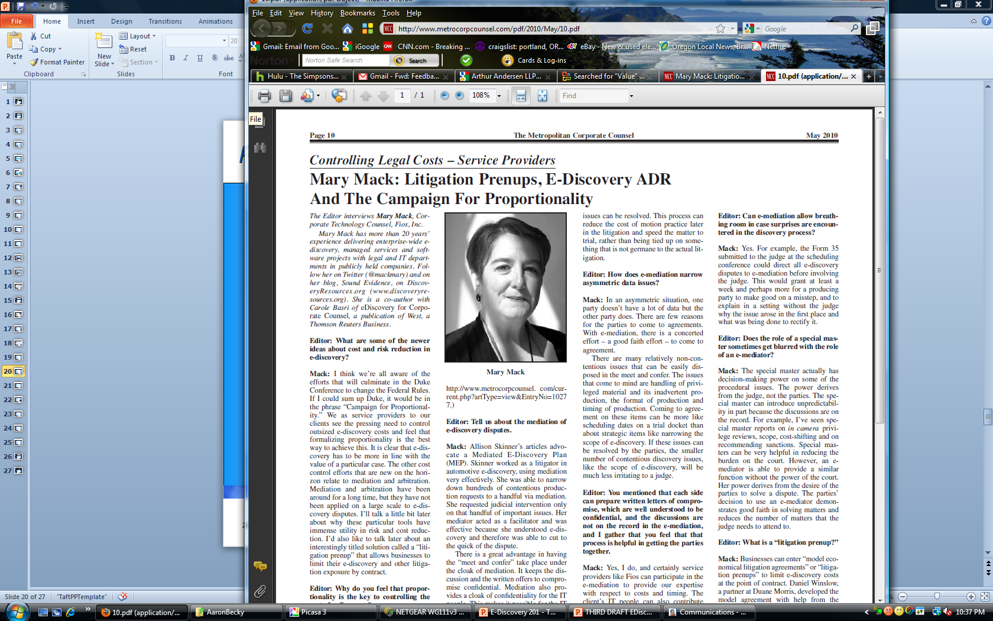
Proportionality - Value of Quantifying
Exposure, Damages
Litigation, e-Discovery, Preservation
Early Assessment CPR

Slide 20
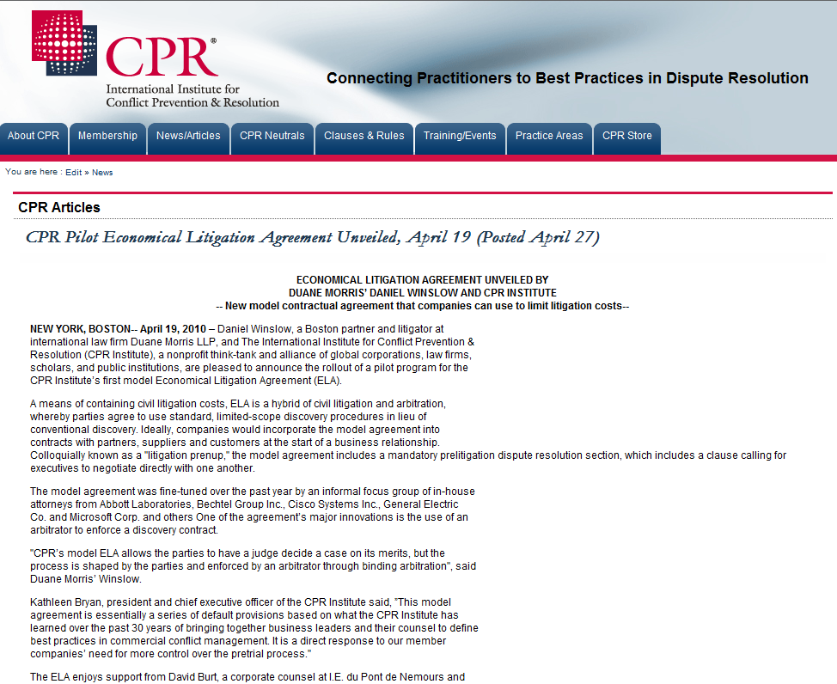
Reduce Costs
Contracts to Reduce Litigation e-Discovery Costs
Litigation Prenup

Slide 21

Document Your Improvements
Baseline First Case
Return On Investment
  Costs
  Early Metrics

Slide 22
Alternative Fees
Predictability
Volume Discounts
Risk Sharing

Slide 23

Reduce Costs by Avoiding Fire Drills
Process to Reduce Internal Costs
Roles, Particularly Person Most Knowledgeable
Pre-existing Relationships and Pricing

Slide 24
E-Discovery/Counsel Convergence
Primary Counsel
Training Program to Avoid Reinventing the Wheel at Hourly Rates

Slide 25
Questions & Answers

Slide 26
for Attending
Thank You

